Slide 1
COMP 471 {
presentation.php
live-demo.php
[Presentation on: PHP]
<h1>
<?php echo “Eliora Horst”; ?>
</h1>
}
Presentation: PHP

Slide 2

PHP{
Personal Home Page/Forms Interpreter
PHP: Hypertext Preprocessor
presentation.html
live-demo.php
<?php echo “A server-side scripting language.” ?>
1994
1997
}
Presentation: PHP

Slide 3
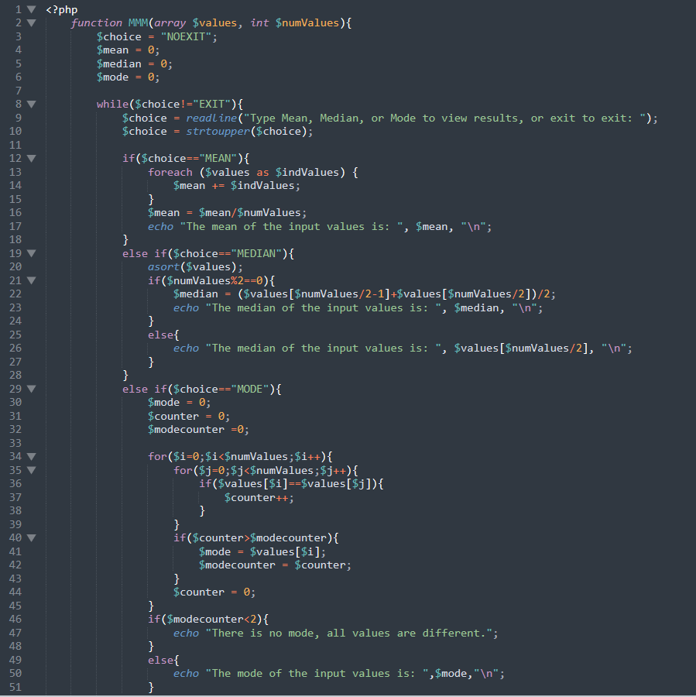
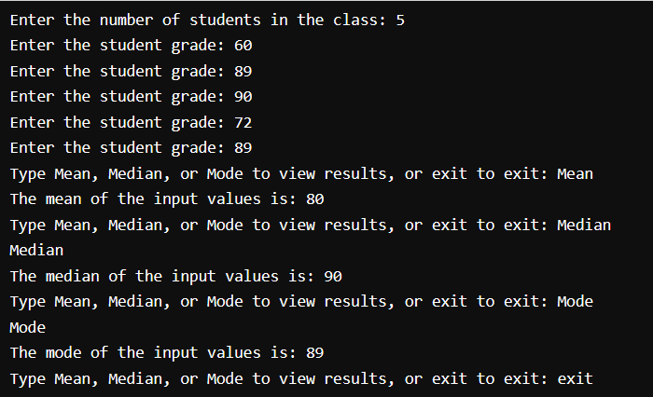
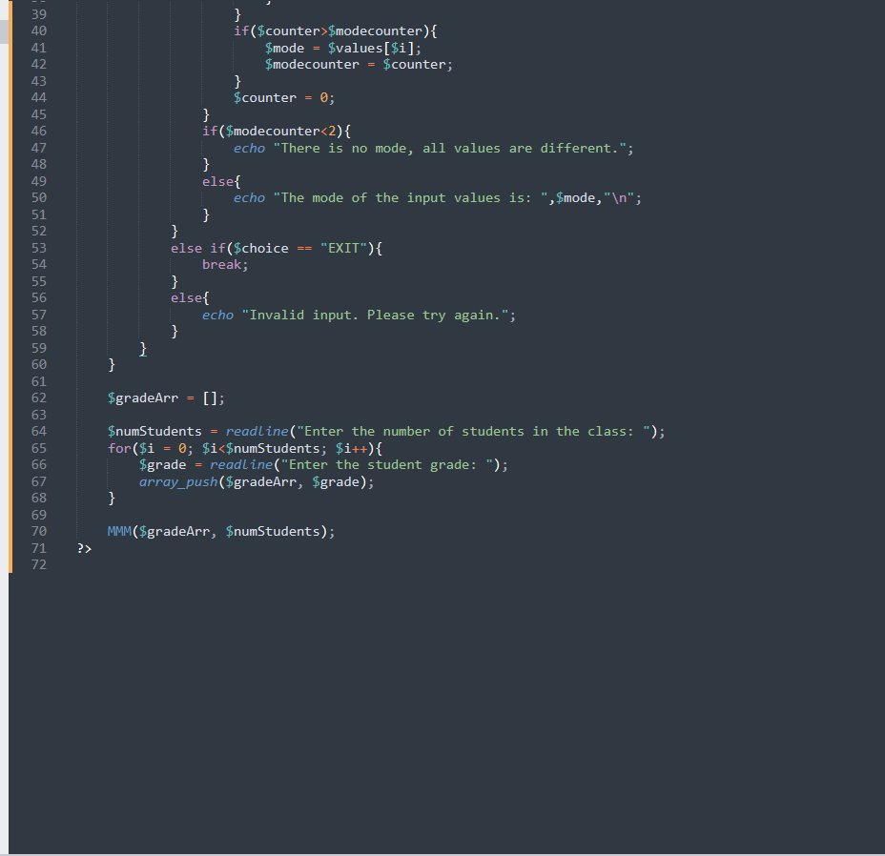
Simple Code Sample {
presentation.php
live-demo.php
}
Presentation: PHP

Slide 4
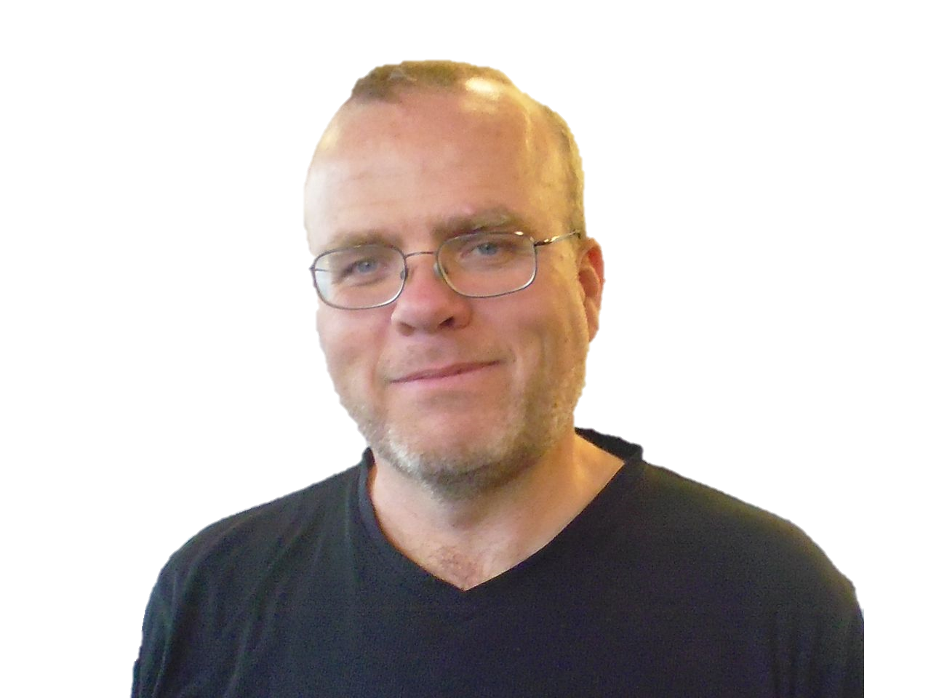
— Rasmus Lerdorf
presentation.php
live-demo.php
< "I don't know how to stop it, there was never any intent to write a programming language [...] I have absolutely no idea how to write a programming language, I just kept adding the next logical step on the way.">
Presentation: PHP

Slide 5
Multi-Paradigm {
presentation.php
live-demo.php
Functional
Imperative
Object-Oriented
Procedural
Reflective
}
Presentation: PHP

Slide 6
Efficiency < /1 > {
presentation.php
live-demo.php
< While there are other products working to improve the efficiency of PHP, the only complete implementation of PHP is run by the Zend Engine, which functions as an interpreter.>
}
Security < /2 > {
< According to the NVD, 9.7% of all vulnerabilities in 2021 were linked to issues in PHP. PHP does not have any inherent input validation and has mutliple known run-time vulnerabilities. >
}
Presentation: PHP

Slide 7
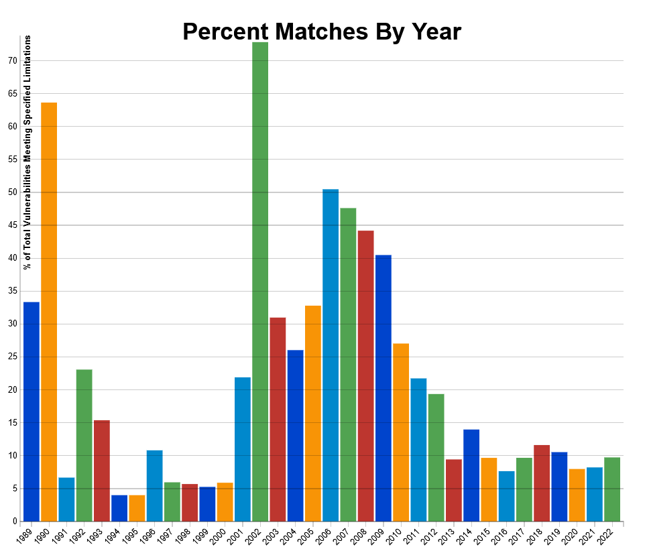
NVD search for PHP {
presentation.php
live-demo.php
}
Presentation: PHP

Slide 8
Portability < /3 > {
presentation.php
live-demo.php
< PHP executes code within delimiters. There are abbreviated forms of these delimiters, but using these versions makes the scripts less portable. Earlier versions also struggled to support unsigned integers.>
}
Community < /4 > {
< PHP continues to include open source libraries, and encourages community involvement. PHP also allows developers to add their own extensions using C. >
}
Presentation: PHP

Slide 9
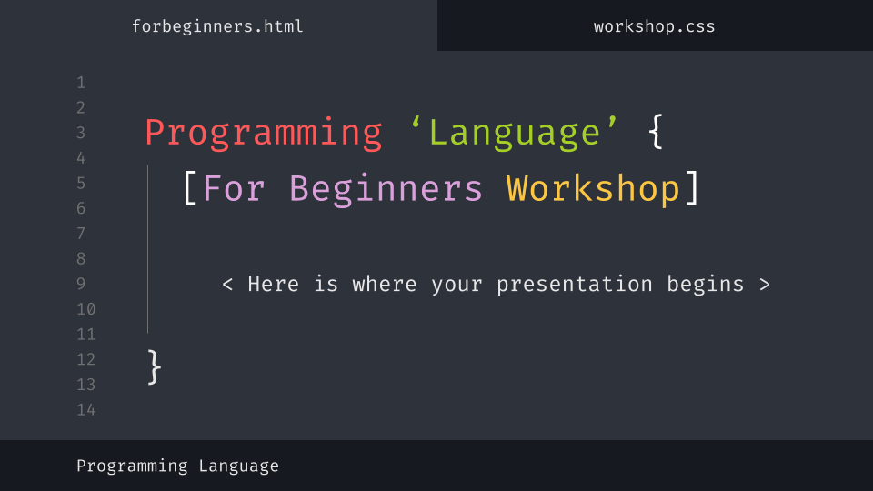
{
presentation.php
live-demo.php
Live Code Demo
}
Presentation: PHP

Slide 10
Conclusion; {
presentation.php
live-demo.php
Constantly Evolving
< PHP is expanding all the time, not just by its core developers, but by web developers everywhere.>
Ubiquitous Online
< PHP is the server-side scripting language of choice for 79.1% of all websites >
Security Struggles
< Major potential flaws in PHP remain unclosed. >
}
Presentation: PHP

Slide 11
Thanks; {
forbeginners.html
workshop.css
Sources{
https://www.percona.com/blog/2007/03/27/integers-in-php-running-with-scissors-and-portability/
https://nvd.nist.gov/vuln/search/statistics?form_type=Basic&results_type=statistics&query=php&search_type=all&isCpeNameSearch=false
https://www.hostinger.com/tutorials/what-is-php/#Scripting_Language_vs_Programming_Language
https://en.wikipedia.org/wiki/PHP
}
< Please keep this slide for attribution >
}
Programming Language

